Slide 1
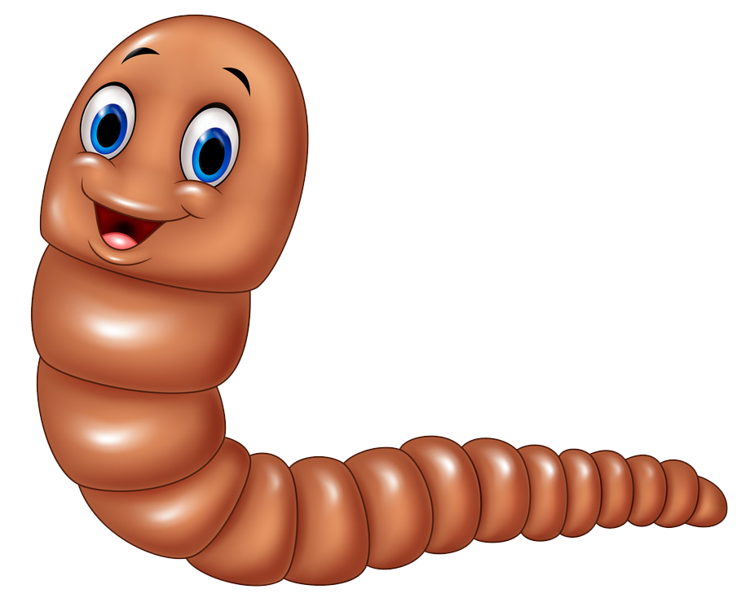
6 Easy Steps Set UP a Worm Bin

Slide 2
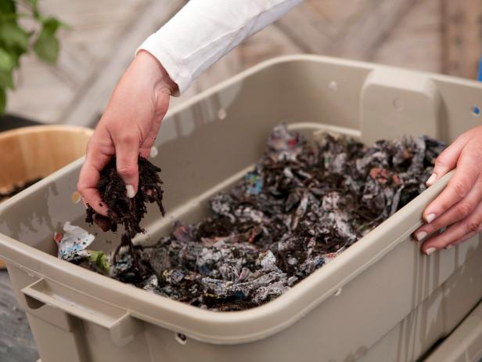
The BIN
Acquire a bin. Approximate size is 16" x 24" x 8" or 10 gallon
Reuse an old dresser drawer
Fish tank,
Build a box out of wood
Find/buy a bin
Make sure the bin is clean by rinsing it with tap water to remove any residues which may be harmful to the worms. For wooden bins, line the bottom and sides with plastic (n old shower curtain or plastic garbage bag works well).

Slide 3
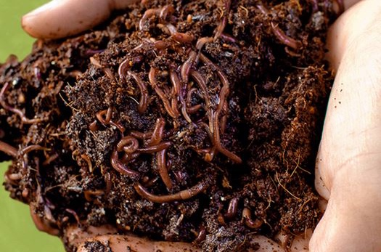
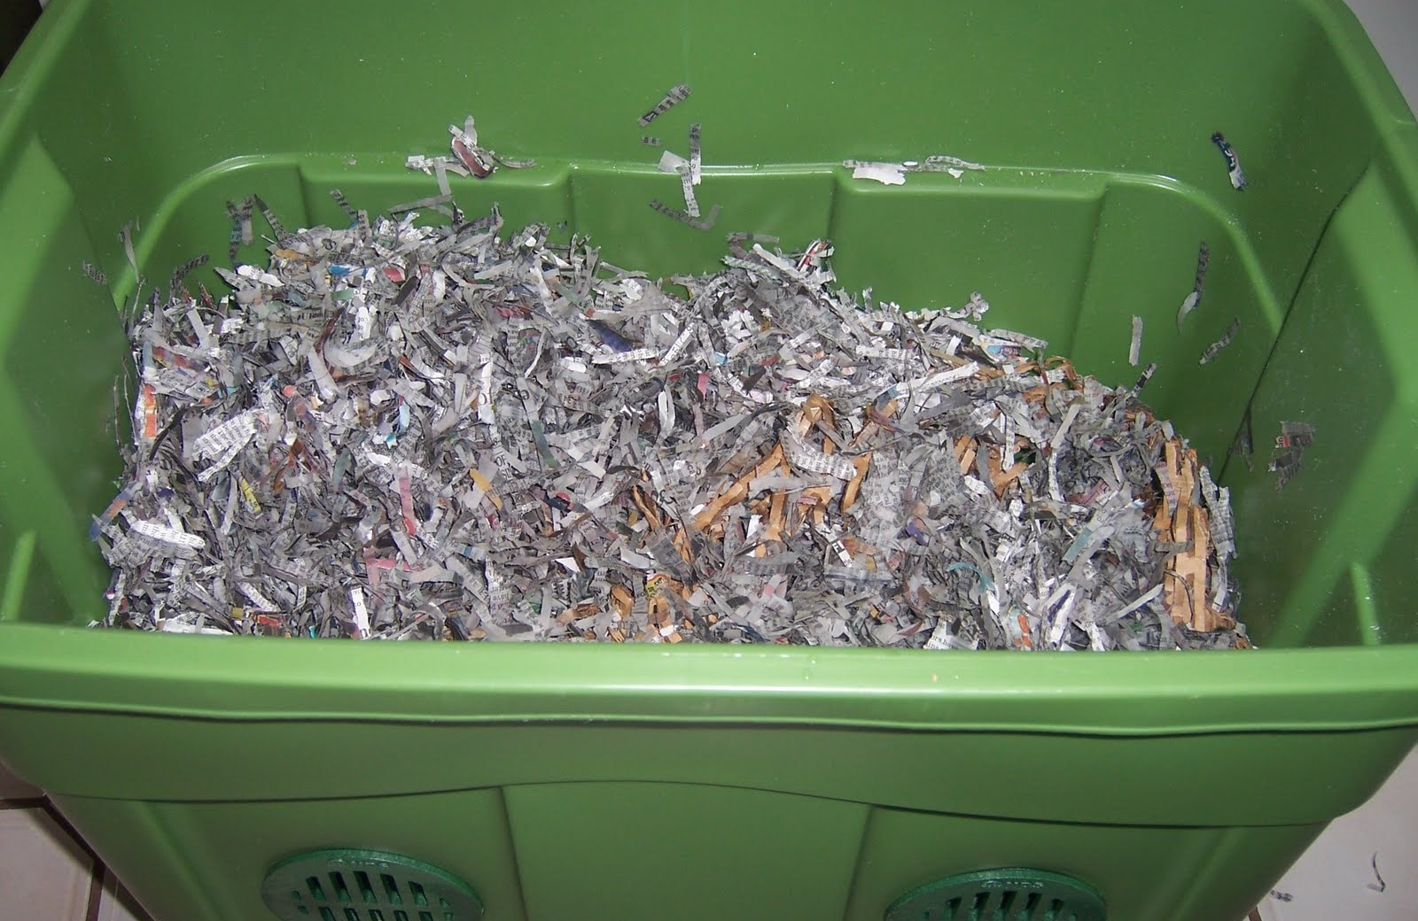
Prepare the Bedding
Instead of soil, composting red worms live in moist newspaper bedding. Like soil, newspaper strips provide air, water, and food for the worms.
Using about 50 pages, tear newspaper into 1/2" to 1" strips. Avoid using colored print, which may be toxic to the worms.
Place newspaper strips into a large plastic garbage bag or container. Add water until bedding feels like a damp sponge, moist but not dripping. Add dry strips if it gets too wet.
Add the strips to the bin, making sure bedding is fluffy (not packed down) to provide air for the worms. Bin should be 3/4 full of wet newspaper strips.
Sprinkle 2-4 cups of soil in bin, which introduces beneficial microorganisms. Gritty soil particles also aids the worms' digestive process. Potting soil, or soil from outdoors is fine.

Slide 4
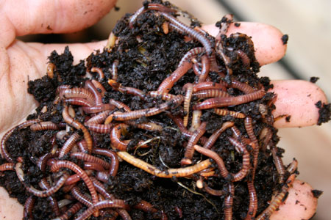
the WORMS
Before adding the worms, find out how many worms you are starting with. The easiest method is to weigh the worms. If you do not have access to a scale, determine the worms' volume. The amount of worms is important for knowing how much food to feed them and for record keeping.

Slide 5
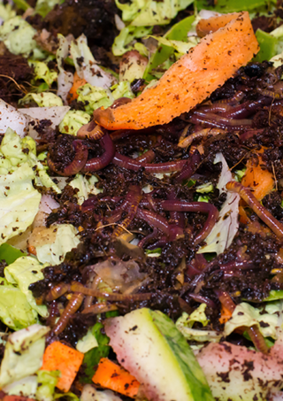
Bury food scraps under bedding
Feed the worms fruit and vegetable scraps that would normally be thrown away, such as peels, rinds, cores, etc. Limit the amount of citrus fruits that you place in the bin. NO MEATS, BONES, OILS OR DAIRY PRODUCTS.
Cut or break food scraps into small pieces – the smaller, the better.
Measure the amount of food. Feed worms approximately 3 times their weight per week. Monitor the bin every week to see if the worms are or are not eating the food. Adjust feeding levels accordingly. (If you start with one pound of worms, add 3 pounds of food per week.)
Bury food scraps in the bin. Lift up bedding, add food scraps, then cover food with bedding.

Slide 6
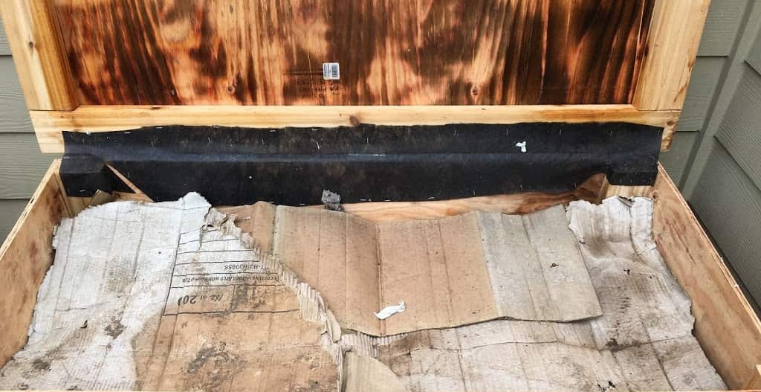
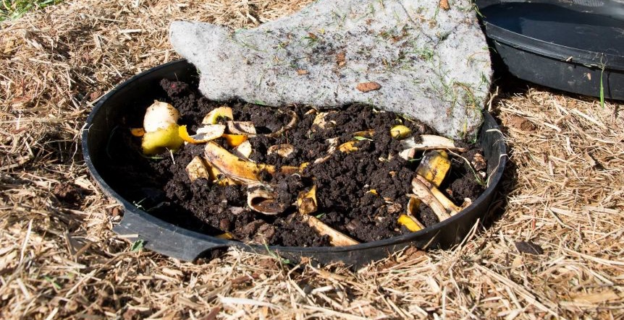
moisture balance
Place a full sheet of dry newspaper on top of the bedding. This will help maintain the moisture balance, keep any possible odors in the bin, and help prevent fruit flies from making a home in the bin. Replace this sheet frequently if fruit flies are present, or if bin gets too wet.

Slide 7
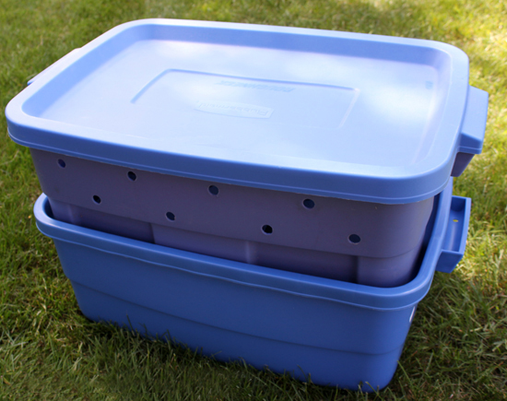
COVER & WAIT
Cover and choose a spot for the bin. Cover the bin with a lid made of plastic, plywood or cloth, but leave the lid ajar so the bin receives some air. If desired, you may drill holes into the bin. Place the bin away from windows and heaters.

Slide 8
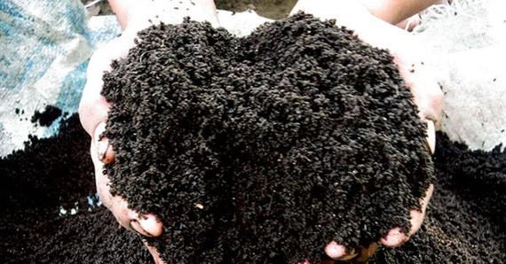
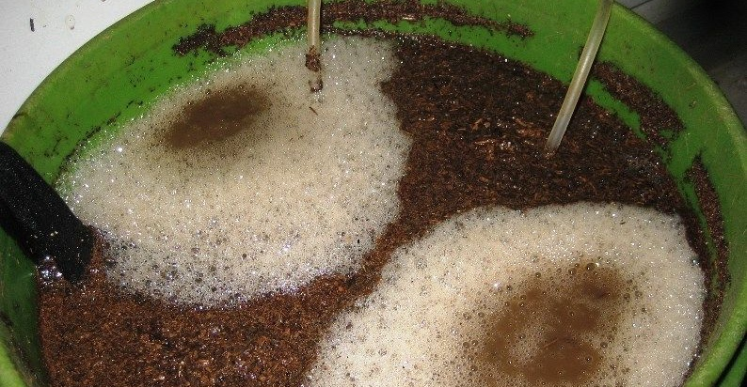
Black gold & Worm Tea
8

Slide 9
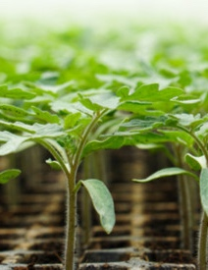
Enjoy the fruits of your labors….
Soilcyclemissoula.com
9

